Slide 1
Software products price detecter
By :
Abdalrahman Al-malah
Al-hasan Shennar
Louy Al-khayat

Slide 2
Roadmap
Scope
Sample of questions
Sample of Code
Difficulties
1
3
5
6
2
4
7
OverView
Data Analysis
References

Slide 3
Scope
Worldwide, many freelancers and companies are looking out for advices to set a price for their projects.
Project Consultant is an expert system that will help developers and companies to pick the best Strategy to Set the price of their products, based on simple questions that will help to have a good look about the project and the pricing methods

Slide 4
OverView
Based on what we’ve seen while working as freelancers or with a company, there is a lot mistakes in setting the prices of software products which leads the developer to Financial loss in the end of a project
As IT engineers, we always look for the best pricing strategy to avoid losing customers or working as a free service.

Slide 5
Samples of questions that we asked
For freelance
-As a developer what is your most faces problem for pricing?
-Are you familiar with any of pricing strategies?
-What is the most common strategy to set a price for a software product?
- How do you consider your level in freelancing?

Slide 6
Samples of questions that we asked
For company:
-What is the type of the Application do you want to set price for?
-What is the type of software product do you want to develop?
-How many developers the project need?

Slide 7
Samples of questions that we asked
work-leaders :
-How match does it cost adding features to web/mobile application?
-What is the most valuable component while developing Web applications?
-How does the time effects the price of software products?

Slide 8
Data Analysis
FLOWSHART,
BLOCK DIAGRAM,
DECISION TREE

Slide 9
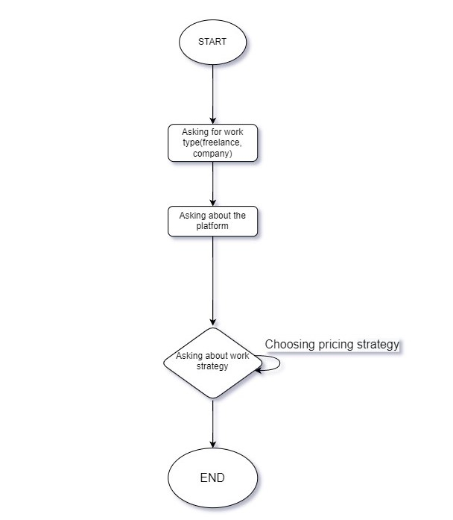
FLOWSHART

Slide 10
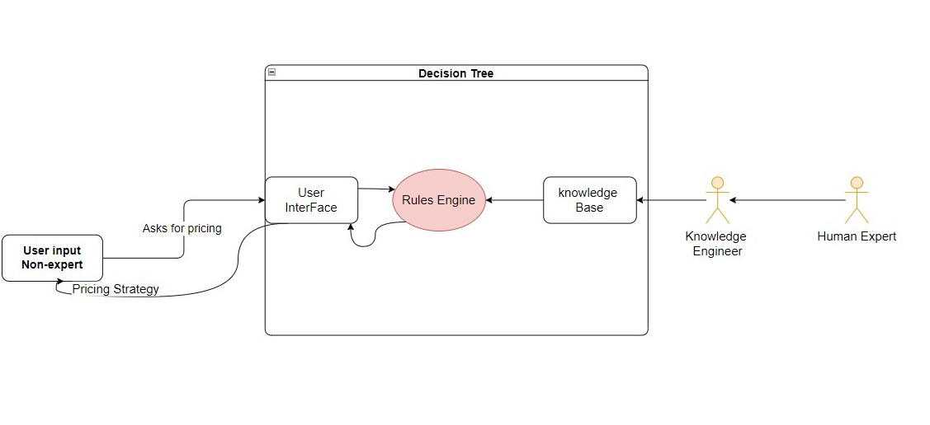
BLOCK DIAGRAM

Slide 11
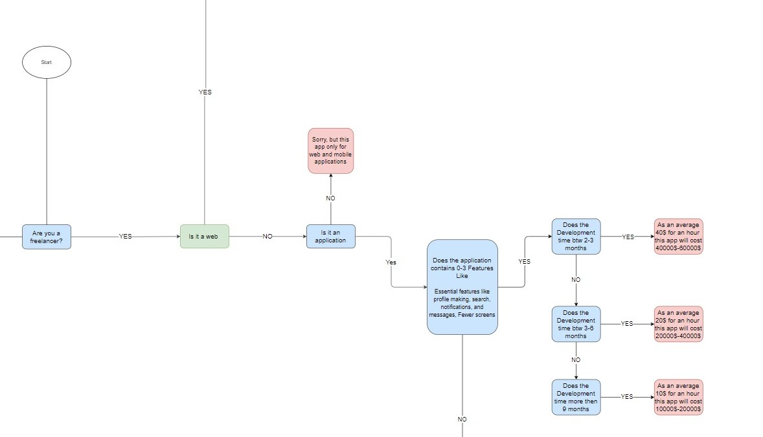
Decision Tree

Slide 12
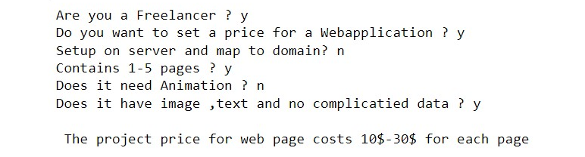
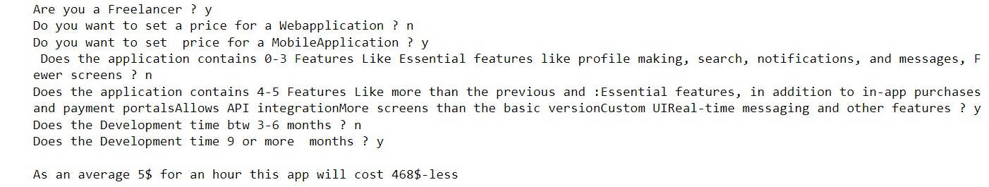
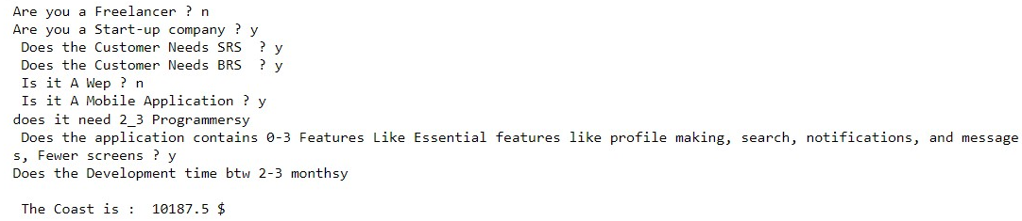
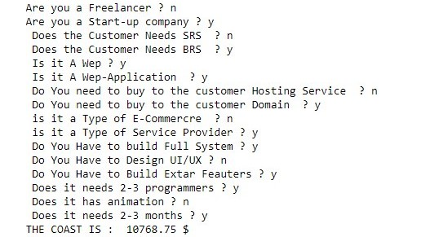
Code Samples
Freelancer: Mobile:
Freelancer: Local web app/No experience:
Company: Mobile:
Company: Ecommerce:

Slide 13
Difficulties
Many strategies for pricing.
Most common strategies Deben on hourly rate.
Different price form country to another.
Hard to decide.

Slide 14
References
www.netsolutions.com
Making Scale-ups & Enterprises Stand Out With Software and Mobile Applications that Matter.
https://wpmudev.com/blog/web-development-pricing-guide/
How To Price Your Web Development Services: The Definitive Guide
https://www.brainiuminfotech.com/services/web-development/?gclid=CjwKCAiA5Y6eBhAbEiwA_2ZWISastRRttmem6z84cQ3FUBYRtP4cfpefqLFWPgnzY8B5i6tTB5157xoCt7gQAvD_BwE
Developers’ salary
https://software.qarbon.it/?gclid=CjwKCAiA5Y6eBhAbEiwA_2ZWISwA3AjAuMeKKEODEpzLY_Jx4qhu_-KDk3W8ff-DnXwfvr-mjZg6GBoC2FoQAvD_BwE
Costs of the products.
https://www.brainiuminfotech.com/services/software-development/?gclid=CjwKCAiA5Y6eBhAbEiwA_2ZWIaBk4oc1SHjCbf4Gb6aQcjphr7lRZF2Nd9PfVExXcWBEyzsjJYSMMxoCeVQQAvD_BwE
BRS&SRS

Slide 15
THANKS!
Any questions?

